Slide 1
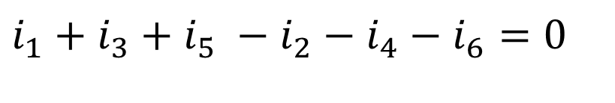
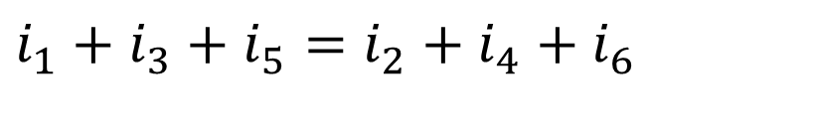
Kirchhoff's Laws - KCL
Kirchhoff's laws help us to solve the electrical networks. There are two laws which are stated as below.
Kirchhoff's current law (Point law or first law)
Its states that, “the algebraic sum of the currents meeting at a junction (node) I equal to zero”. At the node sum of incoming currents = sum of outgoing currents.
Sum of currents entering
Sum of currents leaving
Applying KCL
$$i_{1}+i_{3}+i_{5} −i_{2}−i_{4}−i_{6}=0$$
Or
$$i_{1}+i_{3}+i_{5}=i_{2}+i_{4}+i_{6}$$

Slide 2
Kirchhoff's Laws - KCL
Example
Find the value of i in the figure below.
Solution

Slide 3
Kirchhoff's Laws - KCL
Try
Find the value of i in the figure below.
ANS

Slide 4
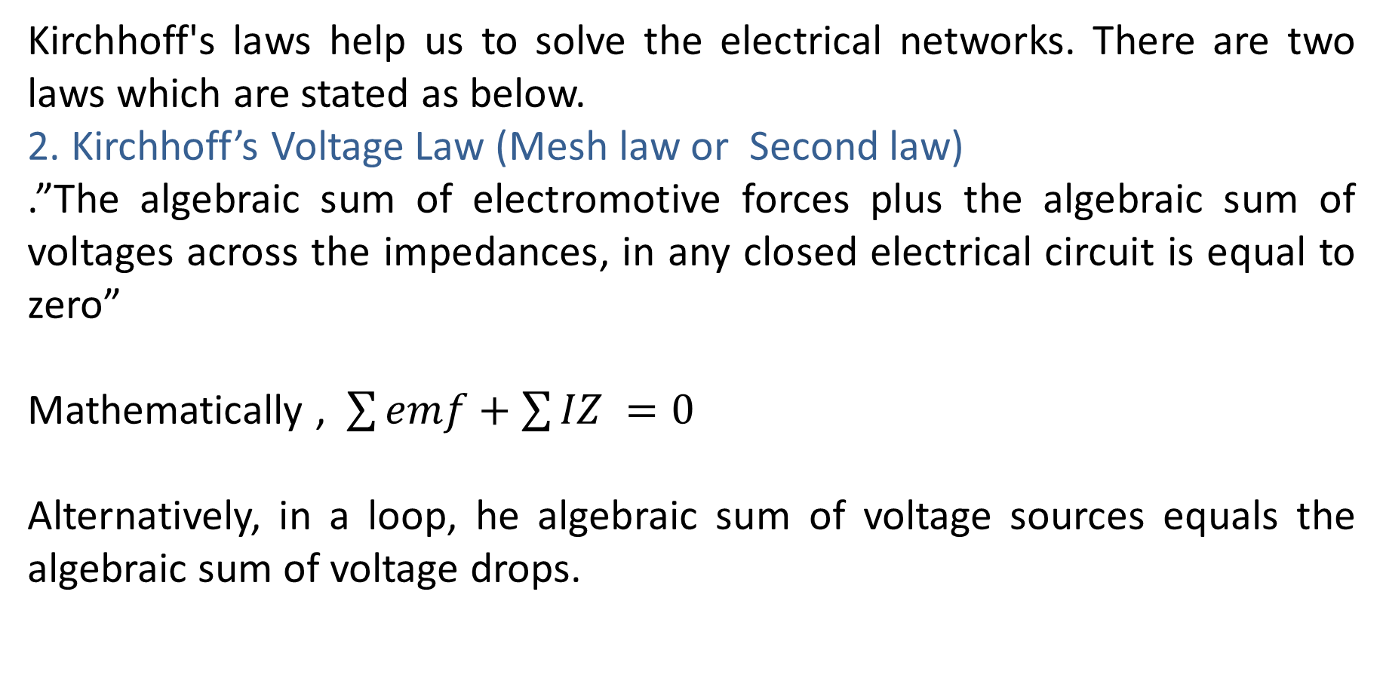
Kirchhoff’s KVL
Kirchhoff's laws help us to solve the electrical networks. There are two laws which are stated as below.
2. Kirchhoff’s Voltage Law (Mesh law or Second law)
.”The algebraic sum of electromotive forces plus the algebraic sum of voltages across the impedances, in any closed electrical circuit is equal to zero”
Mathematically , $\sum{emf}+\sum{IZ }=0$
Alternatively, in a loop, he algebraic sum of voltage sources equals the algebraic sum of voltage drops.

Slide 5


Kirchhoff’s KVL
Note 1:
To determine the sign of electromotive force (emf)
If we go from a +ve terminal of the battery or source to the –ve terminal, there is a fall in potential and so the emf should be assigned negative sign.
If we go from a -ve terminal of the battery or source to the +ve terminal, then, there is a rise in potential and so the emf should be given a positive sign.
It is clear that the sign of emf is independent of the direction of current through it
$$V_{1} will be assigned a negative sign −V_{1}$$
$$V_{1} will be assigned a postive sign+V_{1}$$

Slide 6
Kirchhoff’s KVL
Note 2:
To determine the sign of voltage across the impedance
When current flows through a resistor, there is a voltage drop across it.
If we go through the resistance in the same direction as the current, there is a fall in potential(current flows from higher potential to lower potential). So, the sign of this voltage drop is negative.
If we go opposite to the direction of current flow, there is a rise in potential, and hence, this voltage drop should be given positive sign.. So, the sign of this voltage drop is negative.
It is clear that the sign of the voltage drop (i.e. IR drop) depends upon the direction of current flow and is independent of the polarity of the emf in the circuit under consideration.

Slide 7
Kirchhoff’s KVL
KVL Illustration
KVL
Loop abgha
Loop adeha

Slide 8
Kirchhoff’s KVL
Loop cbgfc
Loop acfha

Slide 9
Kirchhoff’s KVL
Example 1
Find the current in all parts of the circuit below.
Solution
Applying KVL to loop bcdab
Applying KVL to loop ecdfe

Slide 10

Kirchhoff’s KVL
Example 1 cont.
Applying KCL to node c:
Solving the equations simultaneously yields
$$I_{3}=I_{1}+I_{2} (3)$$
I₁ = 4A, I₂ = -1A and I₃ = 3A

Slide 11
Kirchhoff’s KVL
Example 2
Find the current in all parts of the circuit below.
Solution
Applying KVL to loop cefdc
5I₂ + 2 ( I₂ – I₃ ) + 2I₂ - 3 ( I₁ – I₂ ) = 0

Slide 12
Kirchhoff’s KVL
Applying KVL to loop abcda:
Applying KVL to loop ghfeg:
0 = -3I₁ + 12I₂ - 2I₃ (1)

Slide 13
Kirchhoff’s KVL
Example 2 cont.
Solving the three equations:
Simultaneously

Slide 14
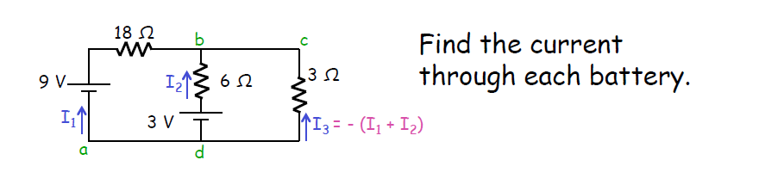
Try 1

Slide 15
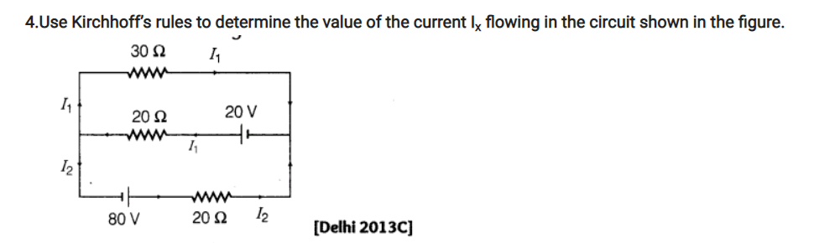
Try 2

Slide 16
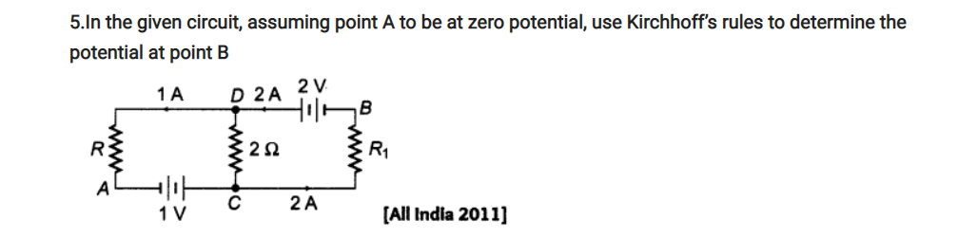
Try 3

Slide 17
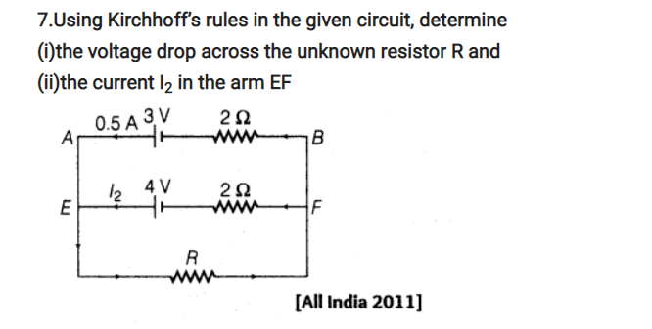
Try 4

Slide 18
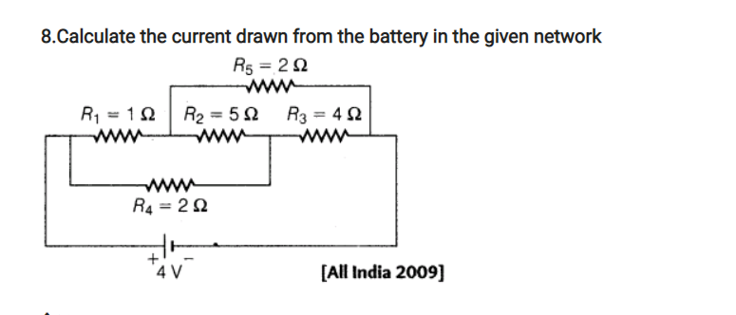
Try 5

Slide 19
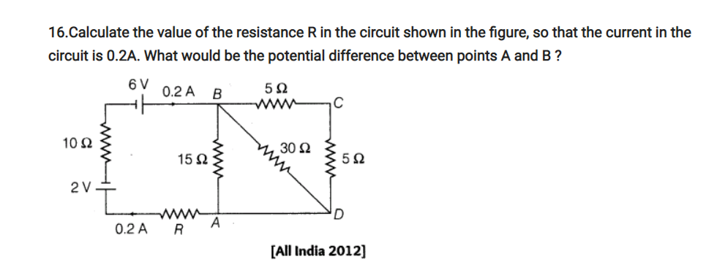
Try 6

Slide 20
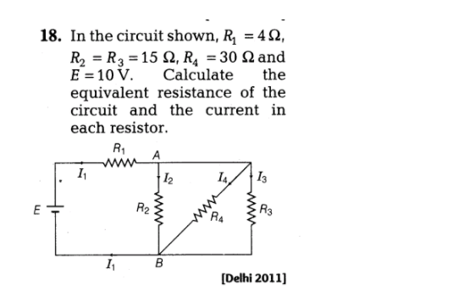
Try 7

Slide 21
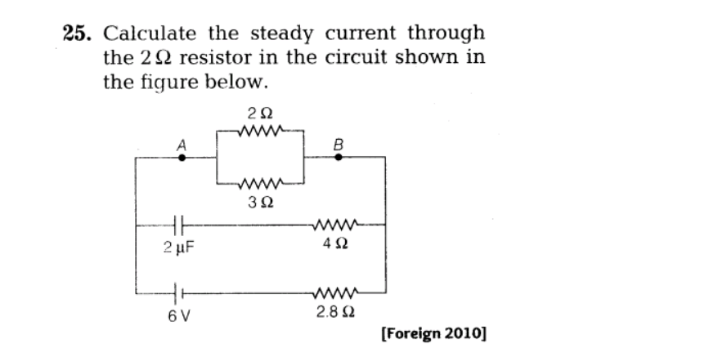
Try 8

Slide 22
Thank You

